Slide 1
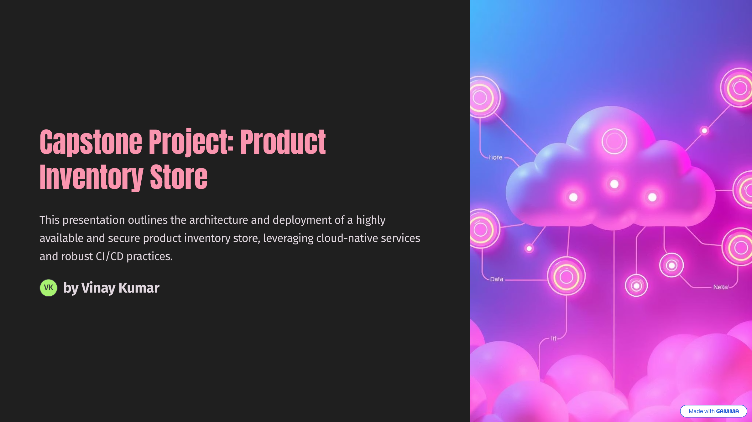

Slide 2
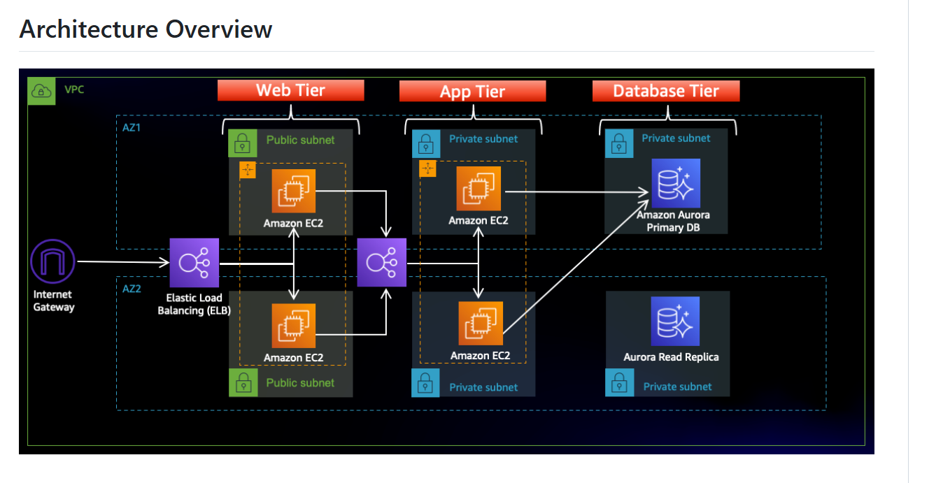
Architecute

Slide 3
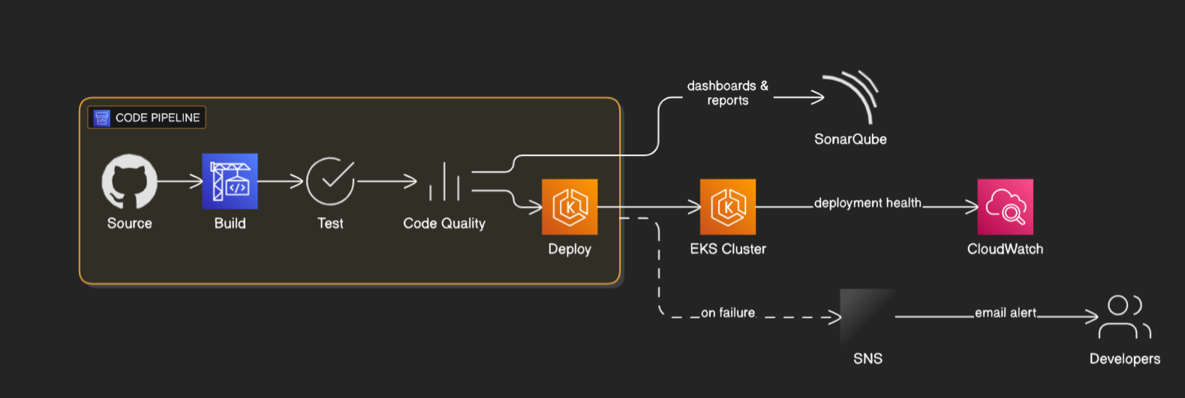
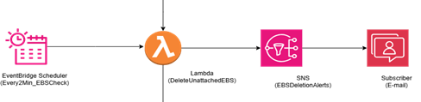
Code pipeline
Alert-if pipeline fails

Slide 4
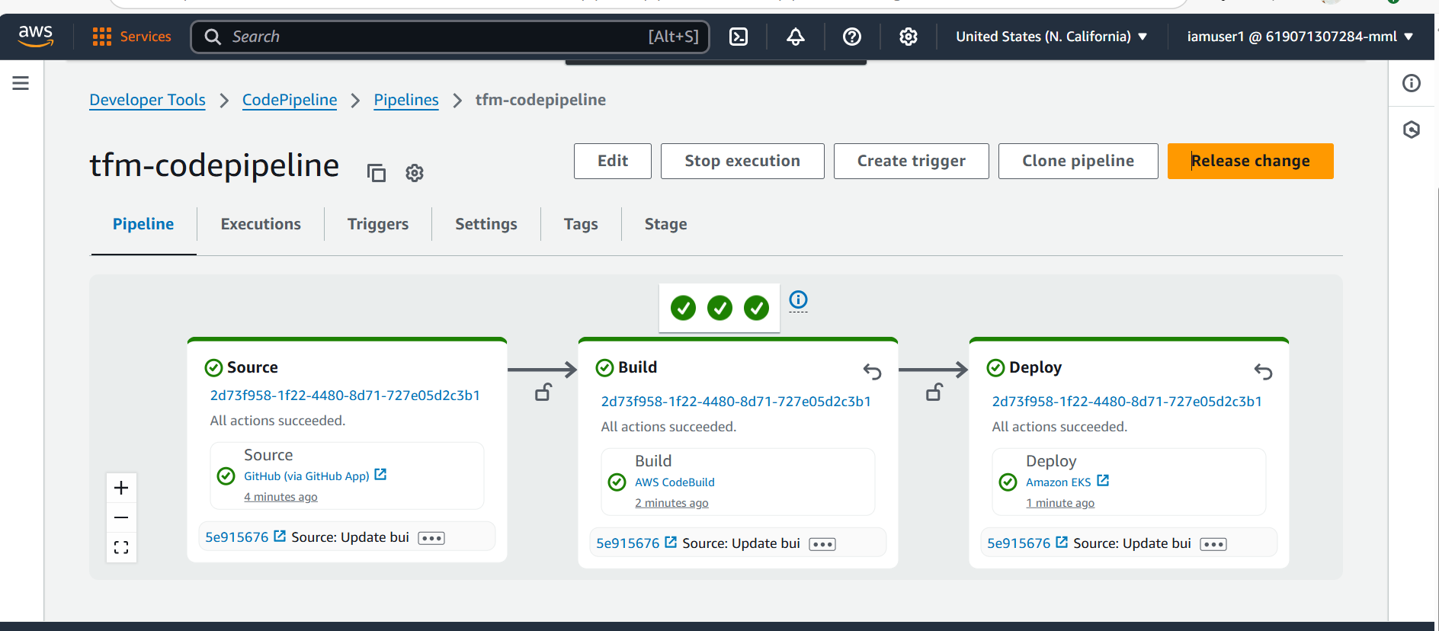
Succes state

Slide 5
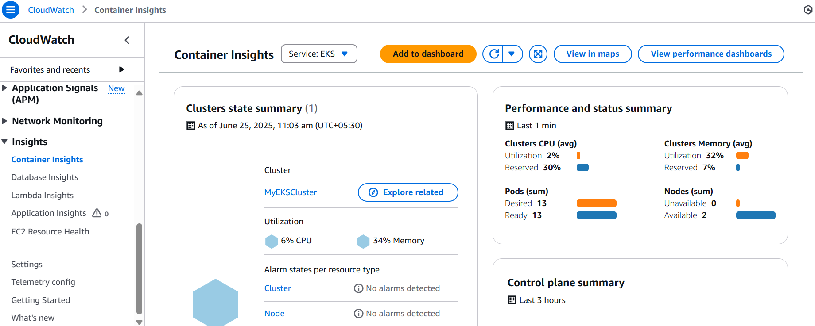
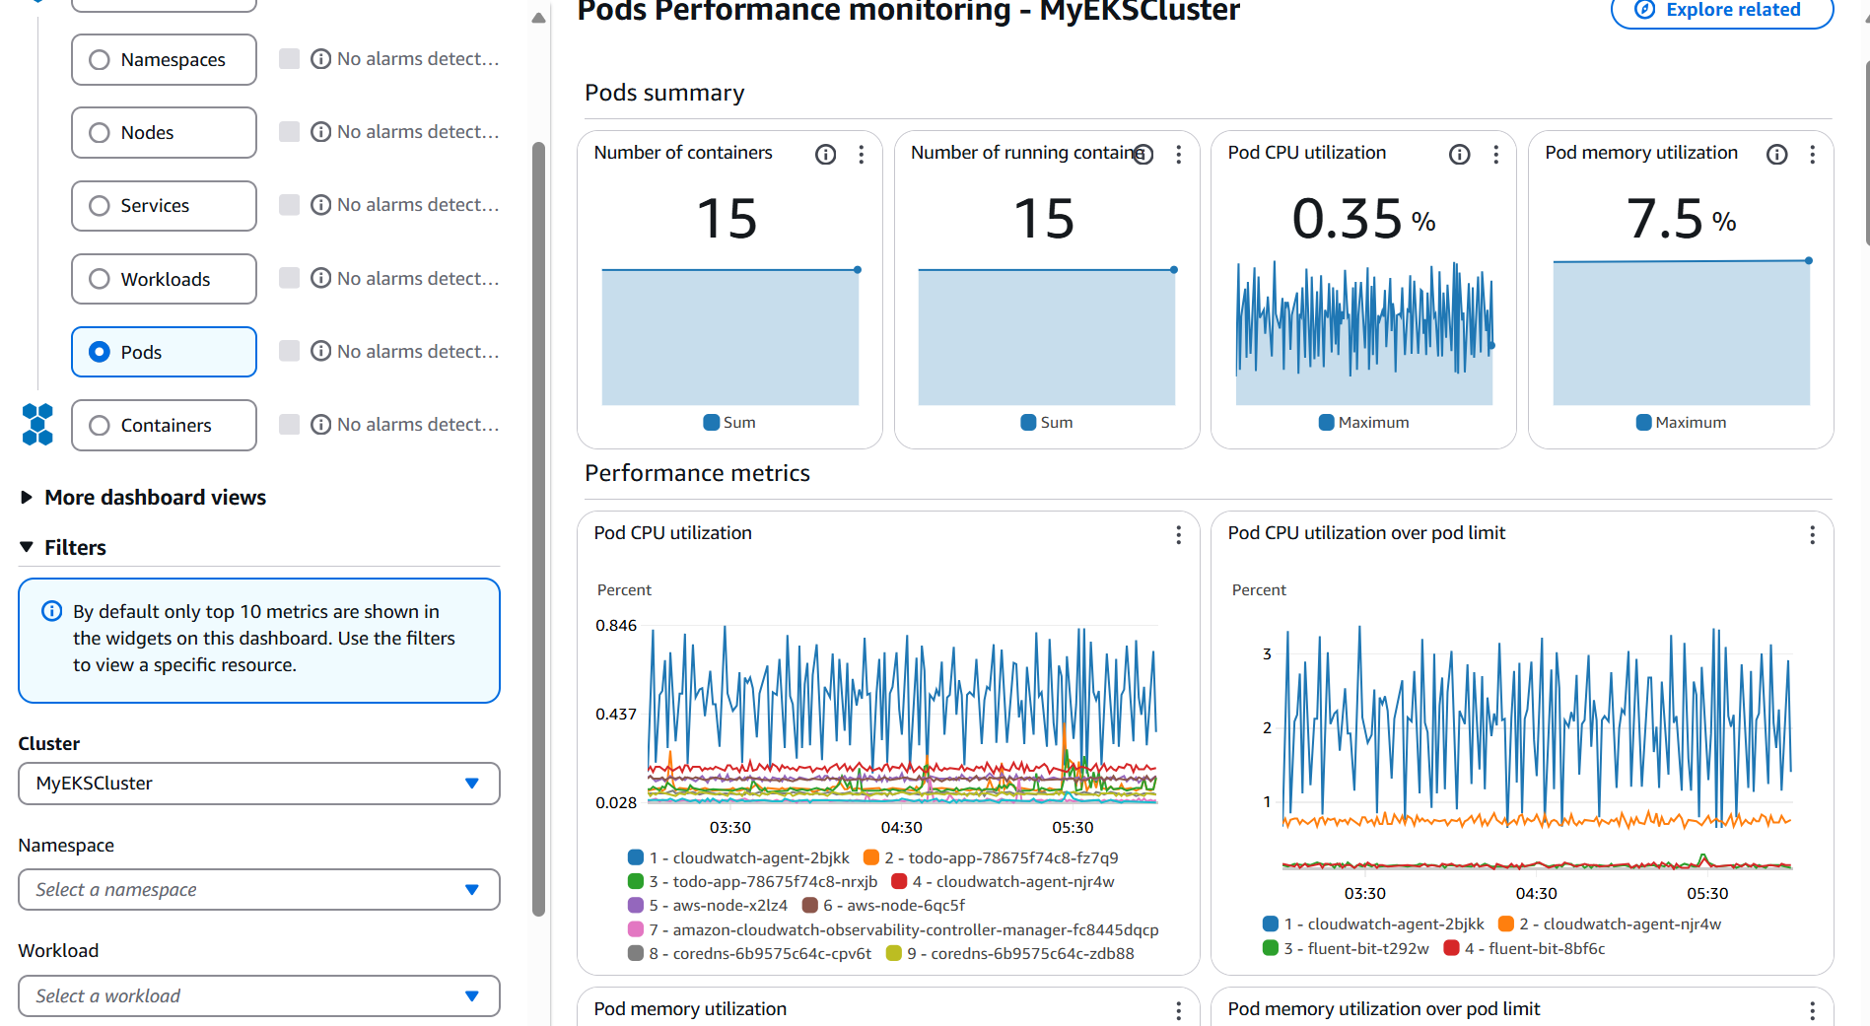
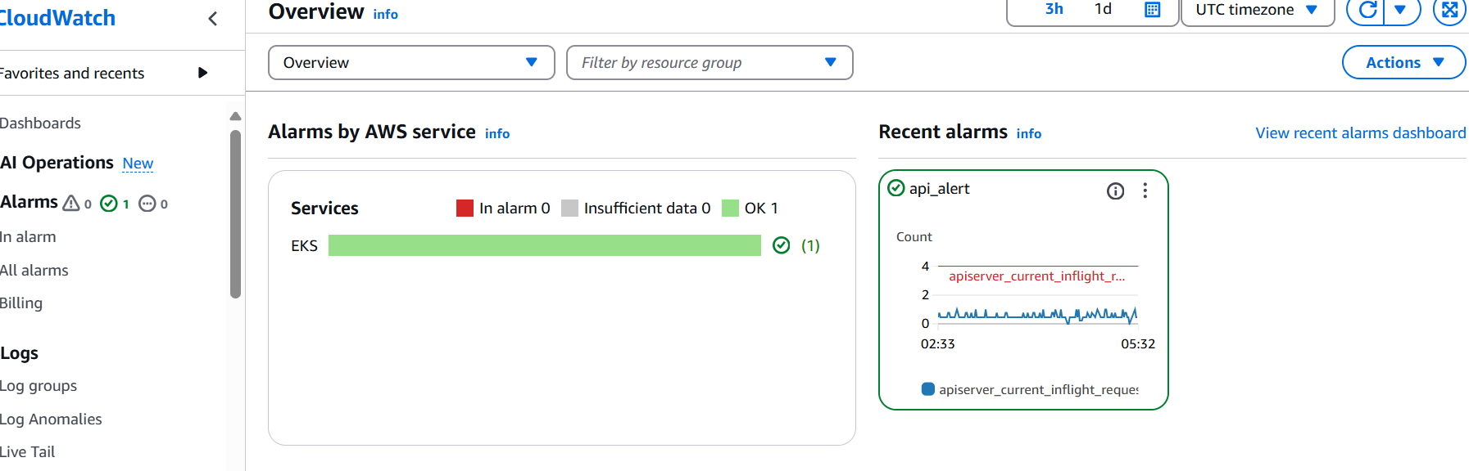
CloudWatch Monitoring -Monitors EKS pod metrics -Alarms configured to trigger on high CPU usage

Slide 6
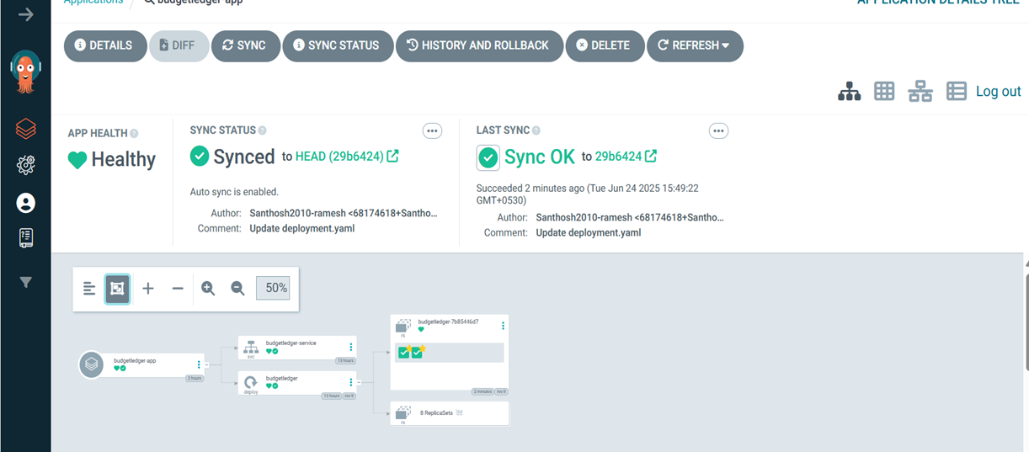
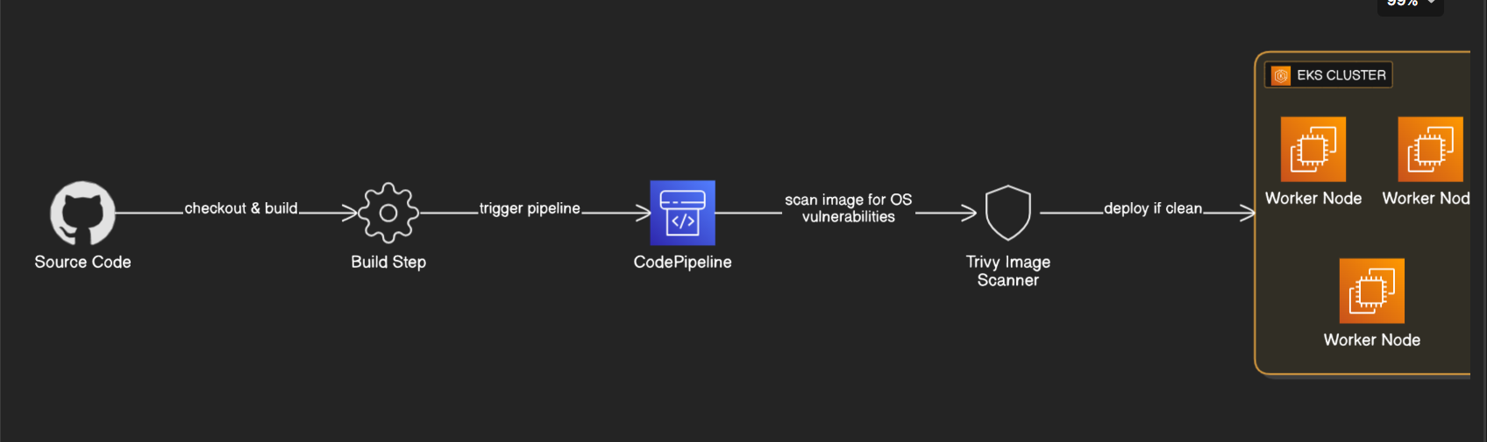
Same infrastructure from(terraform )-region 2

Slide 7
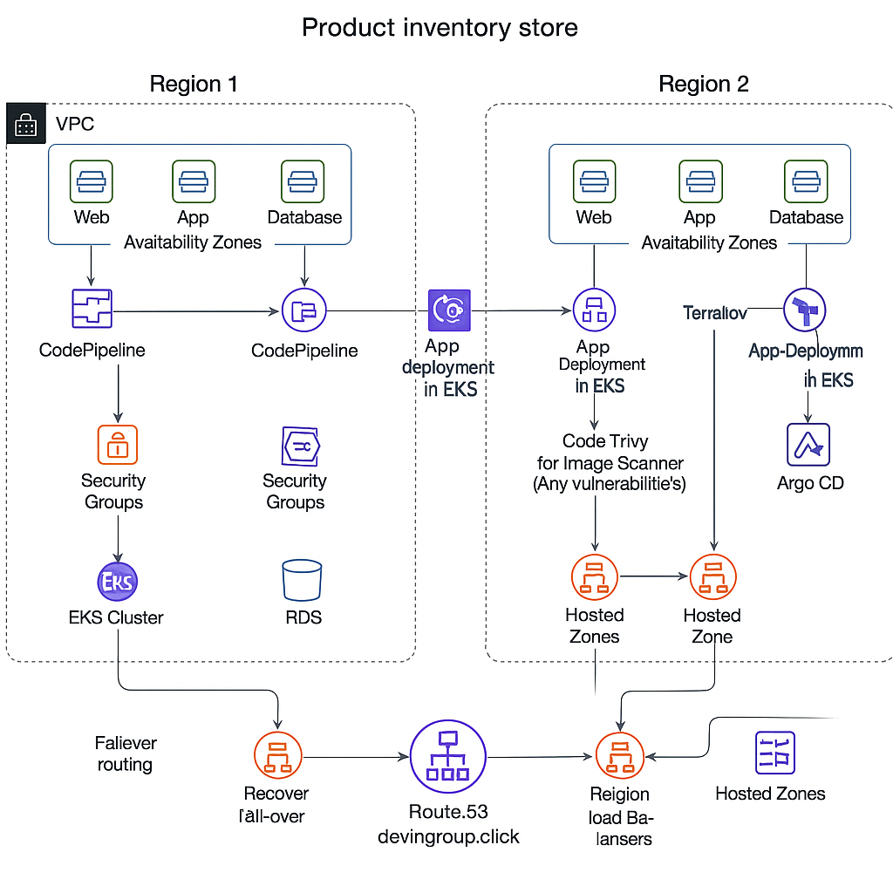
Route 53 (devingroup.click) Configured with two hosted zones for each region. Integrated with regional load balancers. Failover routing policy ensures high availability—if one region goes down, traffic is automatically routed to the healthy region.

Slide 8
Services I have used
Ec2
Iam
Vpc
Internet gatways
Nat gateways
Eks cluster
Ecr
Ecs
Rds
Load balancer
Event bridge
Lamba
Sns
Cloudwatch
Code pipeline
Route 53
Cloud formation

Slide 9
Advantages of Capstone Project
High Availability: Multi-AZ and multi-region setup with Route 53 failover ensures service reliability and disaster recovery.
Scalability: EKS clusters with CloudWatch monitoring enable dynamic scaling based on workload.
Automation & Consistency: Infrastructure as Code using CloudFormation and Terraform enables repeatable, error-free deployments.
CI/CD Efficiency: CodePipeline automates app deployment with integrated code quality checks (SonarQube) and security scanning (Trivy).
Security: Security groups and image vulnerability scanning enhance the system’s security posture.
Monitoring & Alerts: CloudWatch and SNS provide real-time monitoring and failure notifications for quick response.
GitOps Deployment: Argo CD manages Kubernetes deployments declaratively, improving deployment control and visibility.
Reliable DNS Management: Route 53 manages domain routing with failover across regions for uninterrupted access.

Slide 10
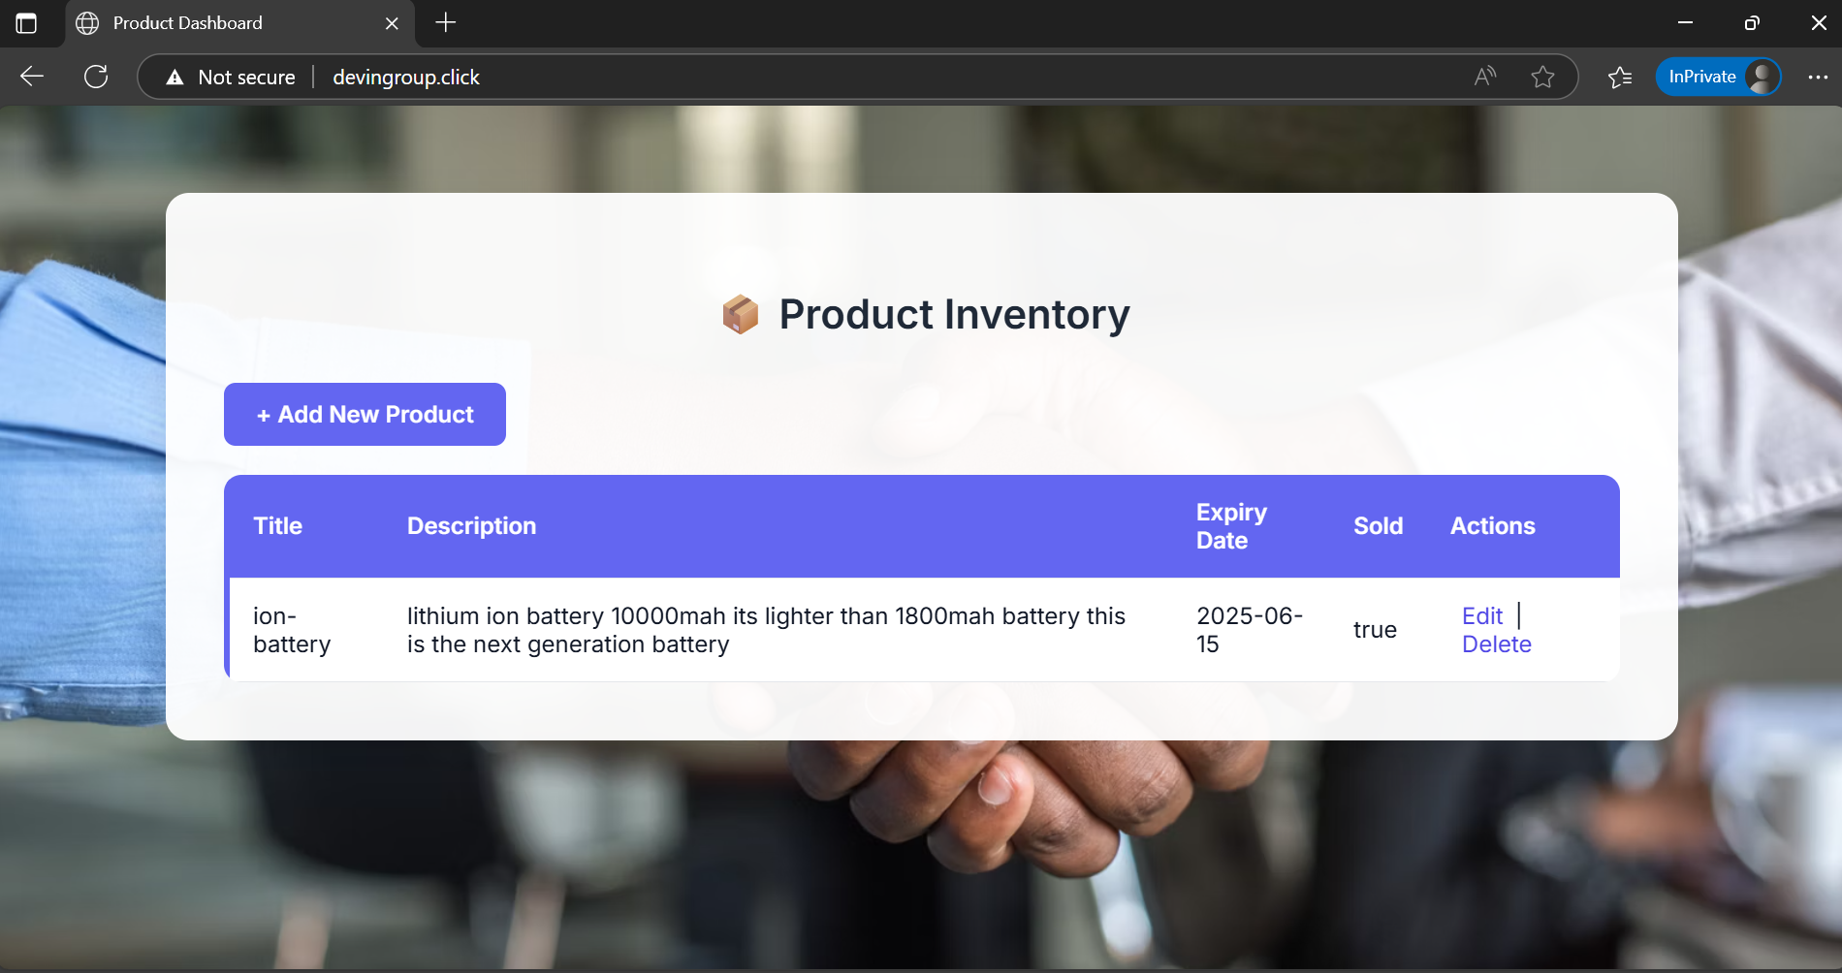
Application

